Slide 1


Precise Vibration Onset Detection for a Cell Phone Application National Center for Adaptive Neurotechnologies
Muhammed Shuaib, Md. Sadman Kabir, Daniel Brown, Nasser AL-Maskari
Dr. Disha Gupta, Dr. N. Jeremy Hill

Slide 2
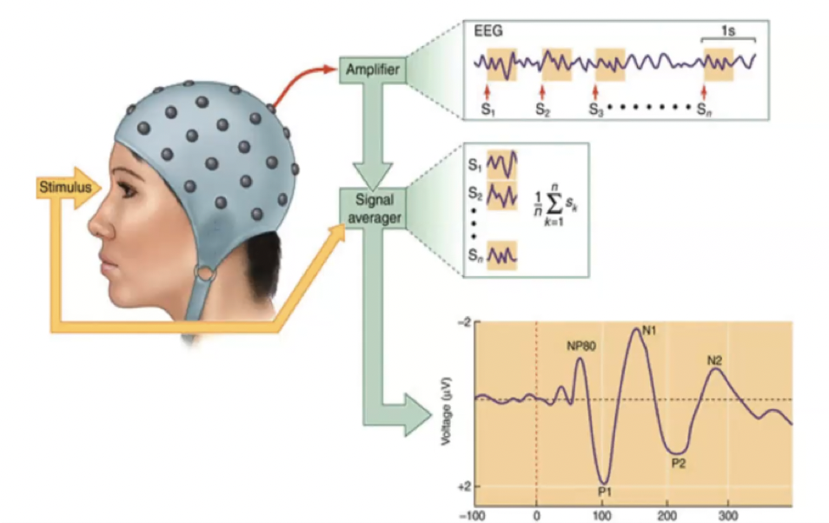
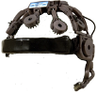
Introduction
There are limited methods available to improve and test during the rehabilitation of brain injury.
We aim to make a cheap and easy-to-use gadget for testing how people feel vibrations. This device should be available home use and not just in hospitals.
The goal is to accurately detect when a vibration onset occurs. This onset is compared to the brain signal generated when the onset occurs. Then accurately record and analyze the data.
.

Slide 3
Agenda
01
Introduction
03
Data and Analysis
02
Our Systems
04
Conclusion
-Background
System Requirements
-Analog Signals
-Digital Signals
-Logical design
-Piezo System
-Accelerometer system
-Radar System
-Results

Slide 4
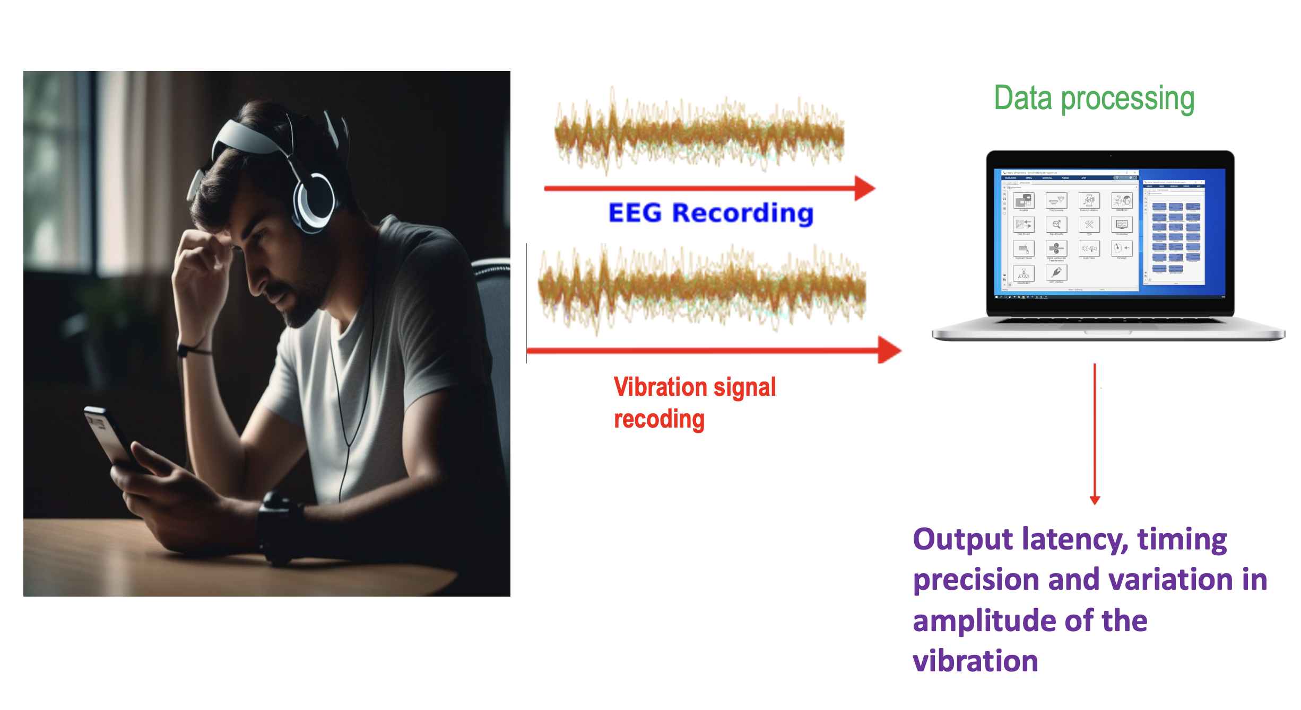
Background and Context
There is need for a device capable of testing tactile sensation with a precise and clean onset to accurately record and analyze data.
Current commercial systems available for measuring vibration are expensive and not available for broad deployment.
Our objective
To design and test various sensors for a new vibro-tactile device that improves upon the limitations of existing commercial systems.

Slide 5
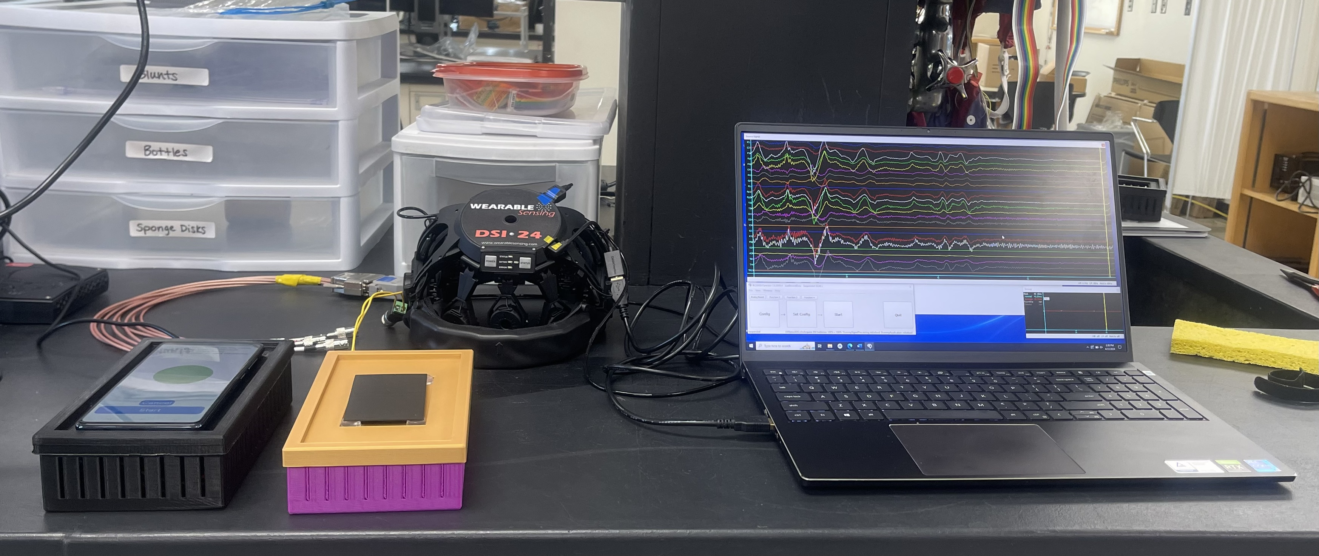
System Requirements
1. Detect Vibration within 5ms
2. On detection, output a digital high in 5ms
3. Under 100$ per system
4. Portable and self-contained system

Slide 6
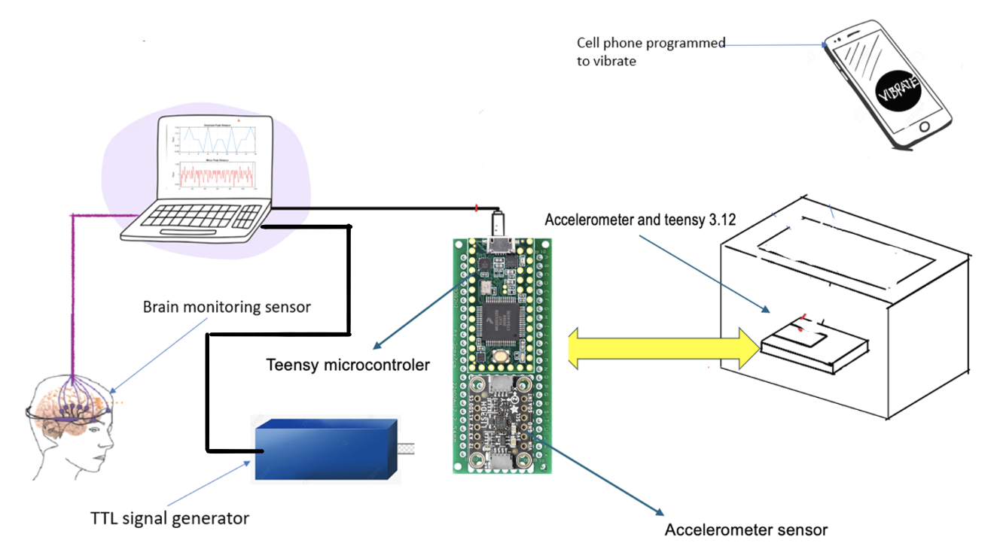
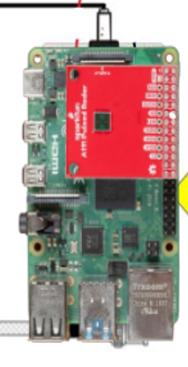
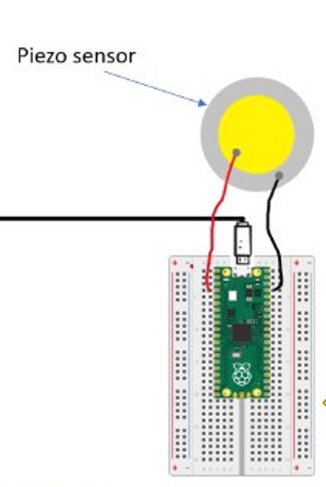
Logical Design
For each of our systems our logical design is the same
In all three cases we have a sensor connected to the pins of our controller
Our controller and sensor varies between system
We use real time code to detect when the sensors pick up vibration
Our controller outputs digital high, which can be detected by our lab equipment.

Slide 7
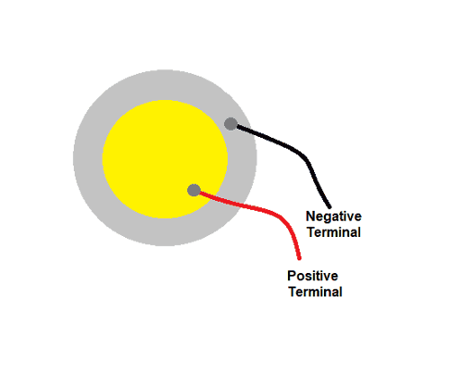
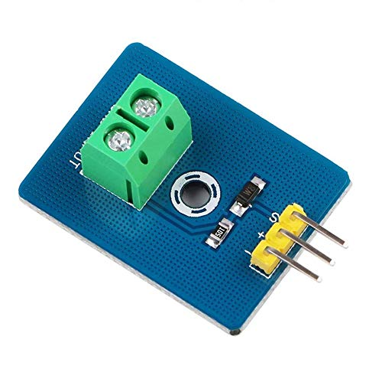
Piezo Sensor
A piezo sensor is a device that can detect changes in pressure, acceleration, temperature, or force by converting them into electrical signals.
Using this device, with an appropriate driver board, we were able to create a clean signal with minimal baseline drift, by reducing the drift from baseline we expect more accurate and precise results in our Piezo System.

Slide 8
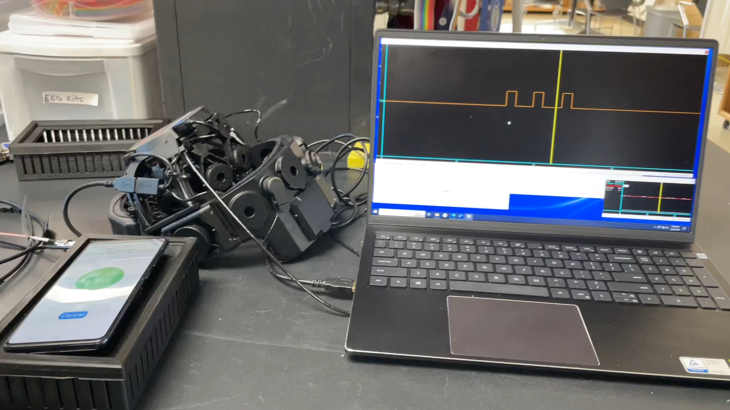
Piezo Sensor Demonstration

Slide 9
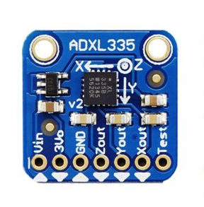
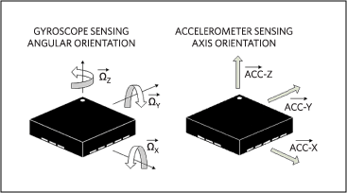
Accelerometer
Our Accelerometer System can detect its position in space in a 3D Co-ordinate System. X Y and Z.
We find the absolute value of the sum of squares of the magnitude of the accelerometer in each direction and set a threshold.
If the vibration is greater than this threshold, we send a digital high signal which is a vibration onset.

Slide 10
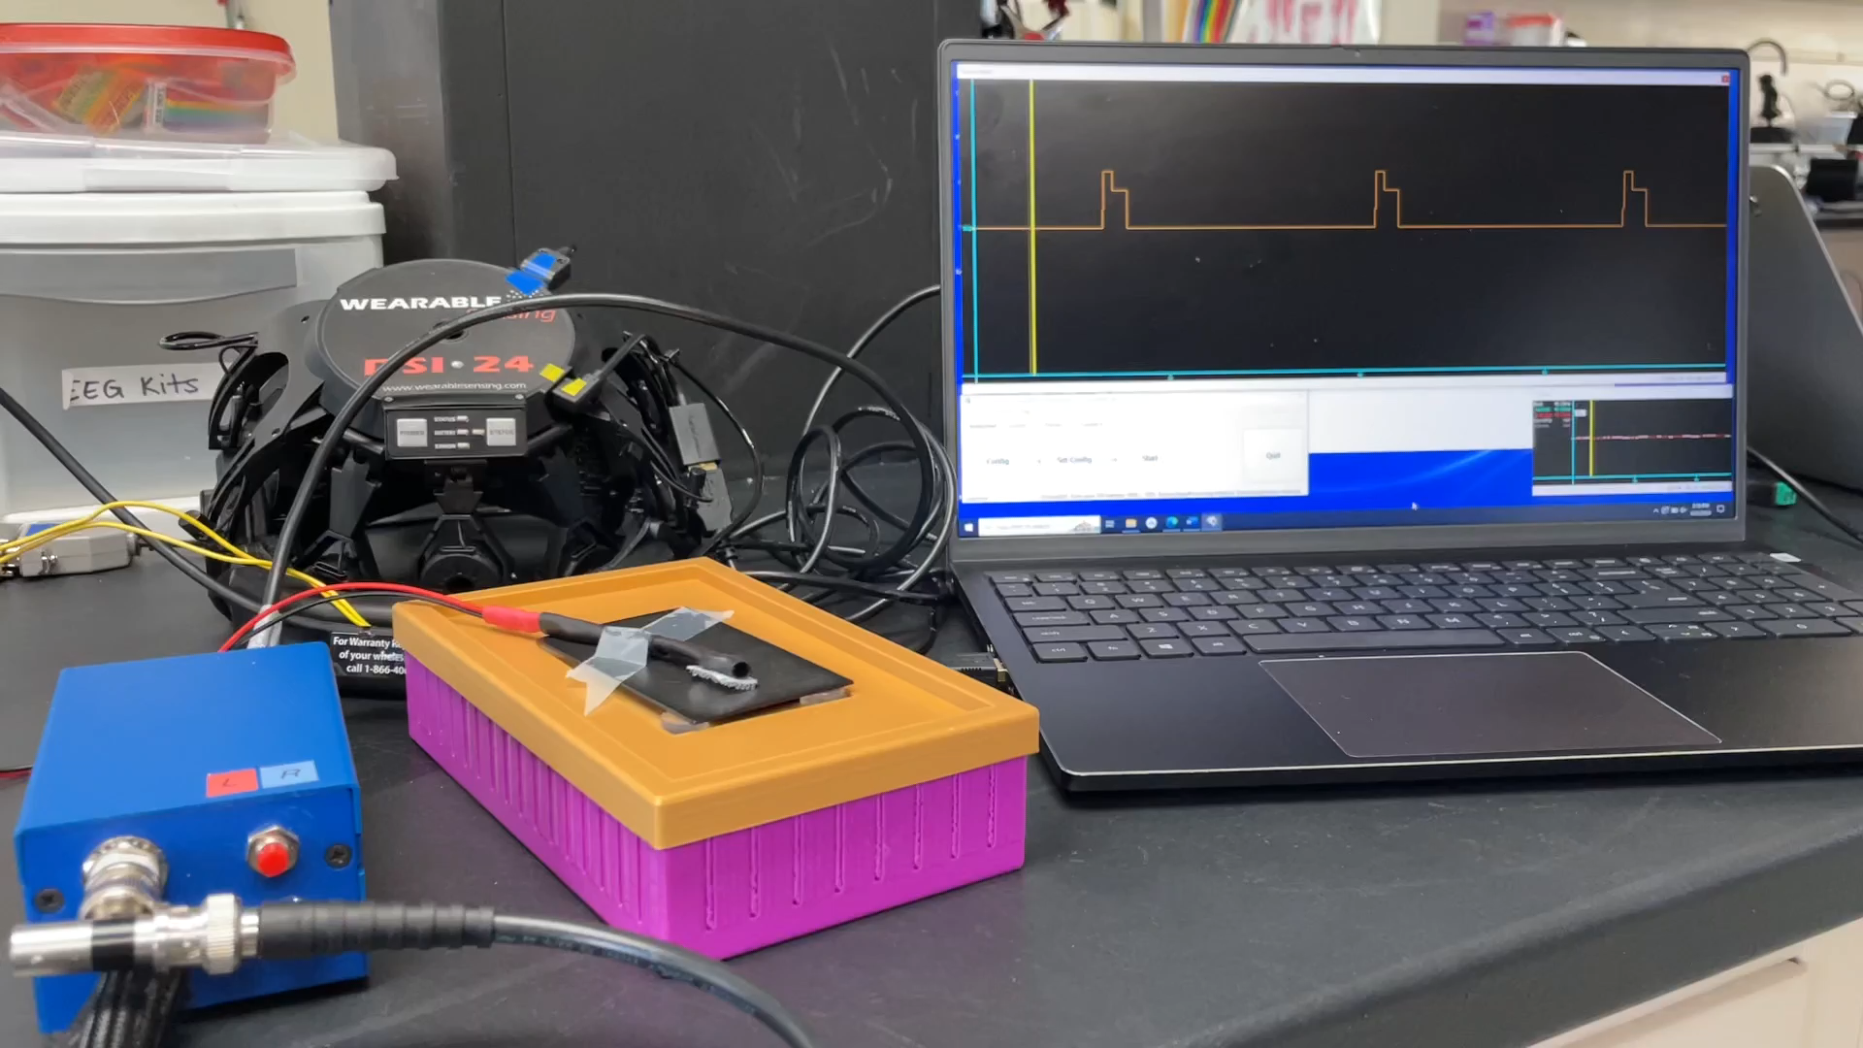
Accelerometer Demonstration
Muhammed

Slide 11
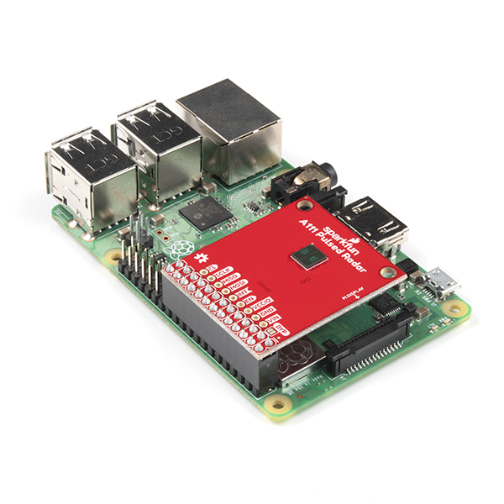
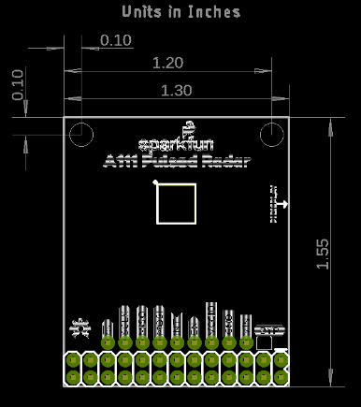
Radar
Our Radar system uses an A111 Pulse Radar to send out a short electromagnetic burst.
It precisely measures the time between initial pulse and detected reflection. This can be used to find the distance.
Our code records the change in distance as a vibration.

Slide 12
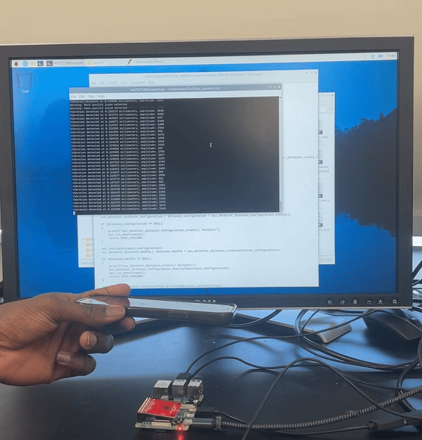
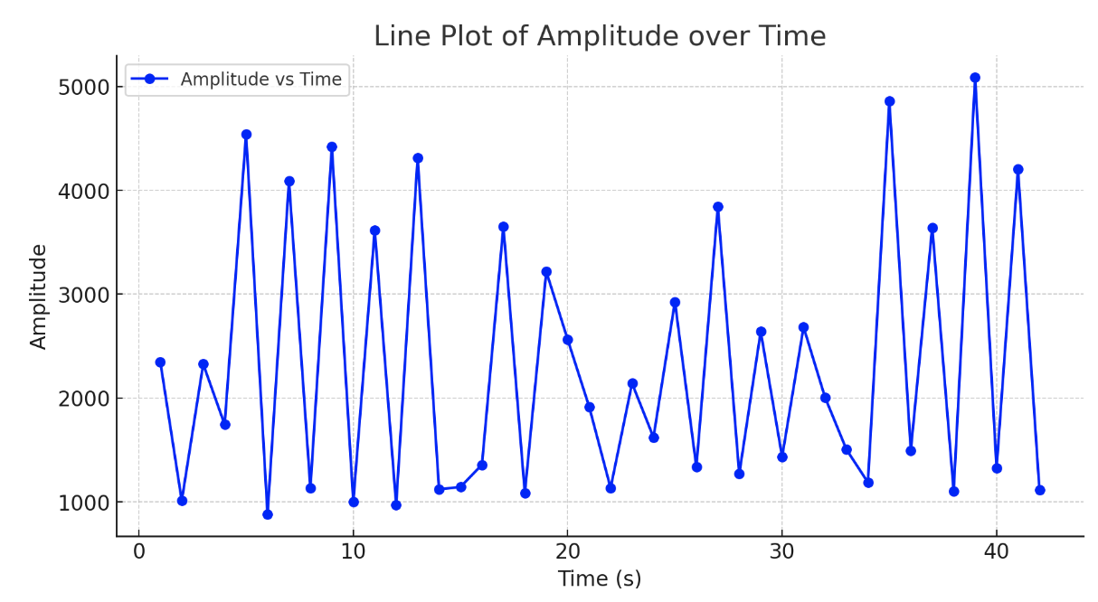
Radar Demonstration
Daniel

Slide 13
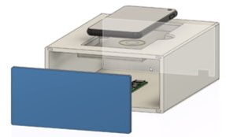
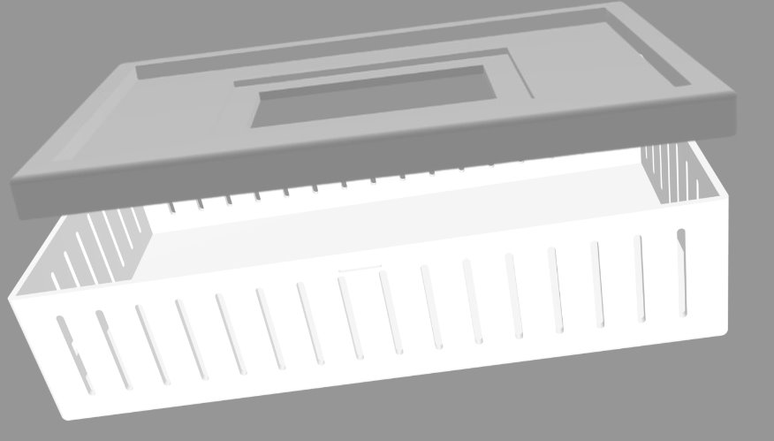
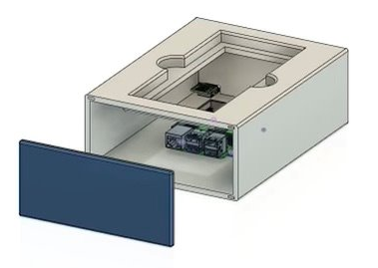
Physical Design
Each of our systems had to have their own Physical design.
The Piezo system required a foam and small hole.
The accelerometer system required the device to be clipped to the box itself.
The Radar system needed a large hole for maximum visibility from the radar.

Slide 14
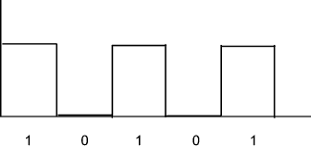
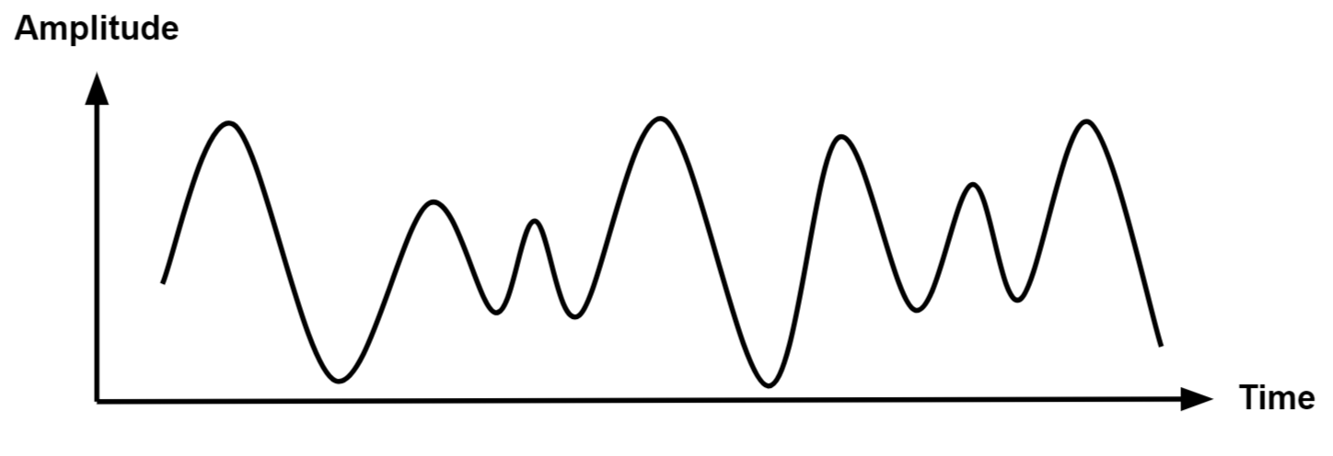
Experiment
Analog Signals
Digital Signals
Analog signals reproduce real-world data
Digital signals convert the data into binary form
Visualize the characteristics of the signal
More sensitive to small changes in vibration
Robustness to noises
Easily processed
Noise Sensitivity
Signal processing

Slide 15
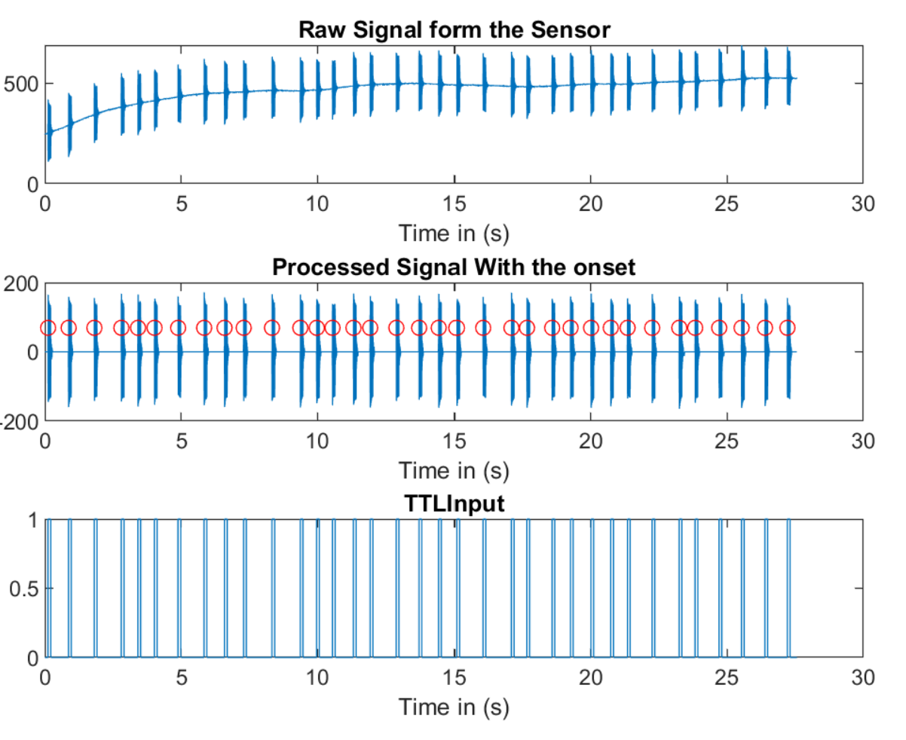
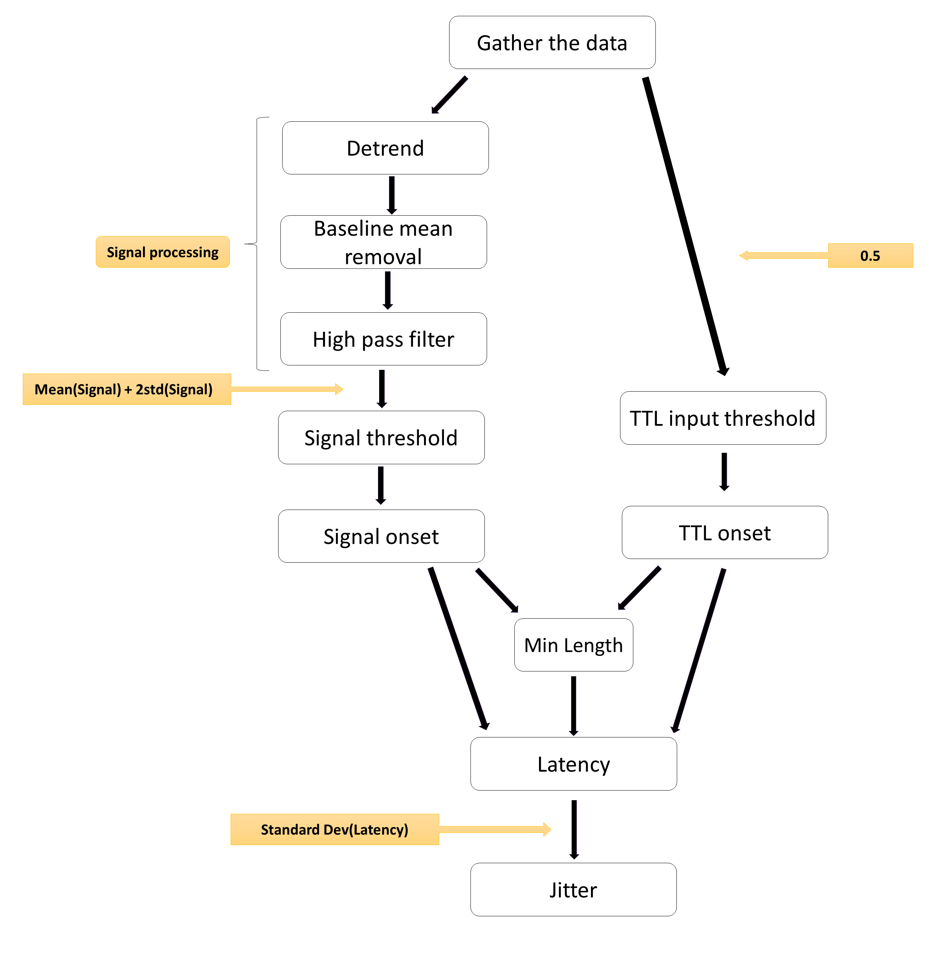
Testing with Analog Signal

Slide 16
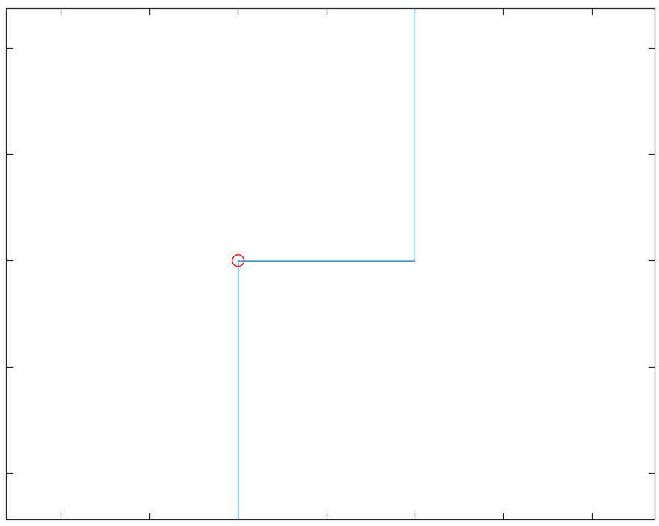
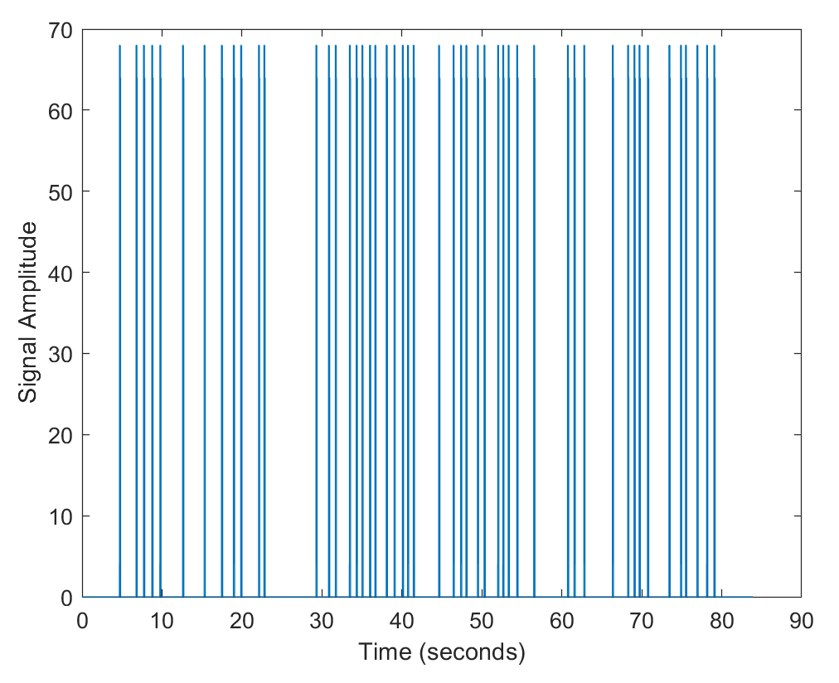
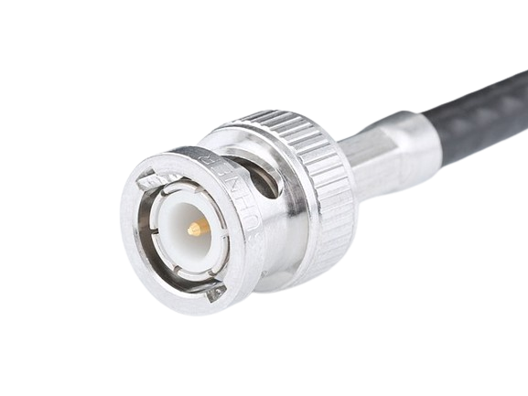
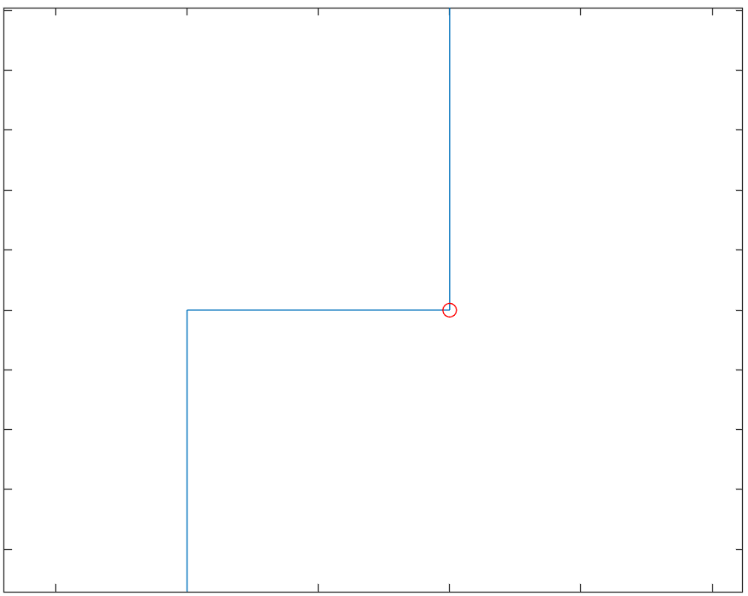
Testing with Digital Signals
BNC connector

Slide 17
Data and Results
 | Piezo Sensor |  | Accelerometer
 | latency (ms) | Jitter (ms) | latency (ms) | Jitter (ms)
Analog Signals | 4.64 | 1.69 | 17.43 | 8.75
Digital Signals | 1.07 | 1.57 | 15.27 | 7.03

Slide 18
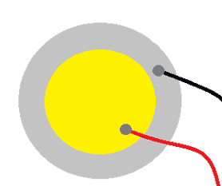
Decision matrix
Criteria | Piezo | Accelerometer
Accuracy | Excellent | Good
Sensitivity | Excellent | Excellent
cost | Excellent | Good
Durability | Good | Excellent
Size | Good | Good

Slide 19
Conclusions Piezo detection: 1.07ms Latency, Jitter 1.57. Goal: <5ms Latency. We found that the latency of the Accerelerometer was higher than that of the Piezo.

Slide 20
Project limitations
01
02
03
Limited time to work on radar systems
Wide range of exploration. Due to use of multiple sensors
No open source code libraries for systems
04
100$ budget

Slide 21
Recommendations for future work
1
Investigate the role pressure has on sensing vibration.
2
More sophisticated real time code.
3
Investigate Other contactless solutions.

Slide 22
Individual Contributions Muhammed Shuaib Support Roles: Treasurer Most Significant Contributions: Designing logical design diagram, Accelerometer research and implementation. Experimentation, Radar implementation. Md. Sadman Kabir Support Roles: Editor Most Significant Contributions: 3D Design of the prototype and printing, Teensy experiments with the Piezo. Daniel Brown Support Roles: Archivist Most Significant Contributions: Piezo and future implementation research. Raspberry Pi Pico experiments with the Piezo. Nasser AL-Maskari Support Roles: Point of contact, Scheduler Most Significant Contributions: Data and result implementation, MATLAB signal acquisition, Experimentation.

Slide 23
Questions?

